Slide 1

Bsides Spl²² Summary Index Idempotency

Slide 2


Hello!
Chris Kaye a.k.a. ITWhisperer
Employed by BT
Using Splunk since 2018
Joined Community 2020
Inducted to Trust 2021
@ITWhisperer

Slide 3

Agenda
Problem statement
Data set
The Dashboard
Data sources
Summary indexes
Idempotency
Subsearches
Caveats and other usecases

Slide 4

Problem Statement
How to update a summary index without double counting
Summary indexes are often used to maintain aggregated statistics
These statistics are typically grouped by time periods e.g. days
Sometimes, these statistics need updating

Slide 5
Problem Statement
Transactions
Access Log
Index
Summary Index
:00
Start & duration A
1 transaction
A
Start & duration B
B
Start & duration A
:05
Start & duration B
:10

Slide 6

Dataset
Buttercup Games (Splunk tutorial)
https://docs.splunk.com/Documentation/Splunk/9.0.0/SearchTutorial/Systemrequirements#Download_the_tutorial_data_files
Specifically, vendor_sales sourcetype * 10
Create a new field called Region which is calculated as being VendorID / 100
Create a further overlapping set of vendor_sales data to represent “late” data

Slide 7
Additional Vendor Sales
index=buttercupgames sourcetype=vendor_sales
| eval increment=1
| eval VendorID=VendorID+increment
| eval AcctID=AcctID+increment
| eval _time=_time+increment
| eventstats values(Code) as Codes
| eval Code=mvindex(Codes,(mvfind(Codes,Code)+increment)%mvcount(Codes))
| eval _raw="[".strftime(_time,"%d/%b/%Y:%H:%M:%S")."] VendorID=".VendorID." Code=".Code." AcctID=".AcctID
| table _raw

Slide 8

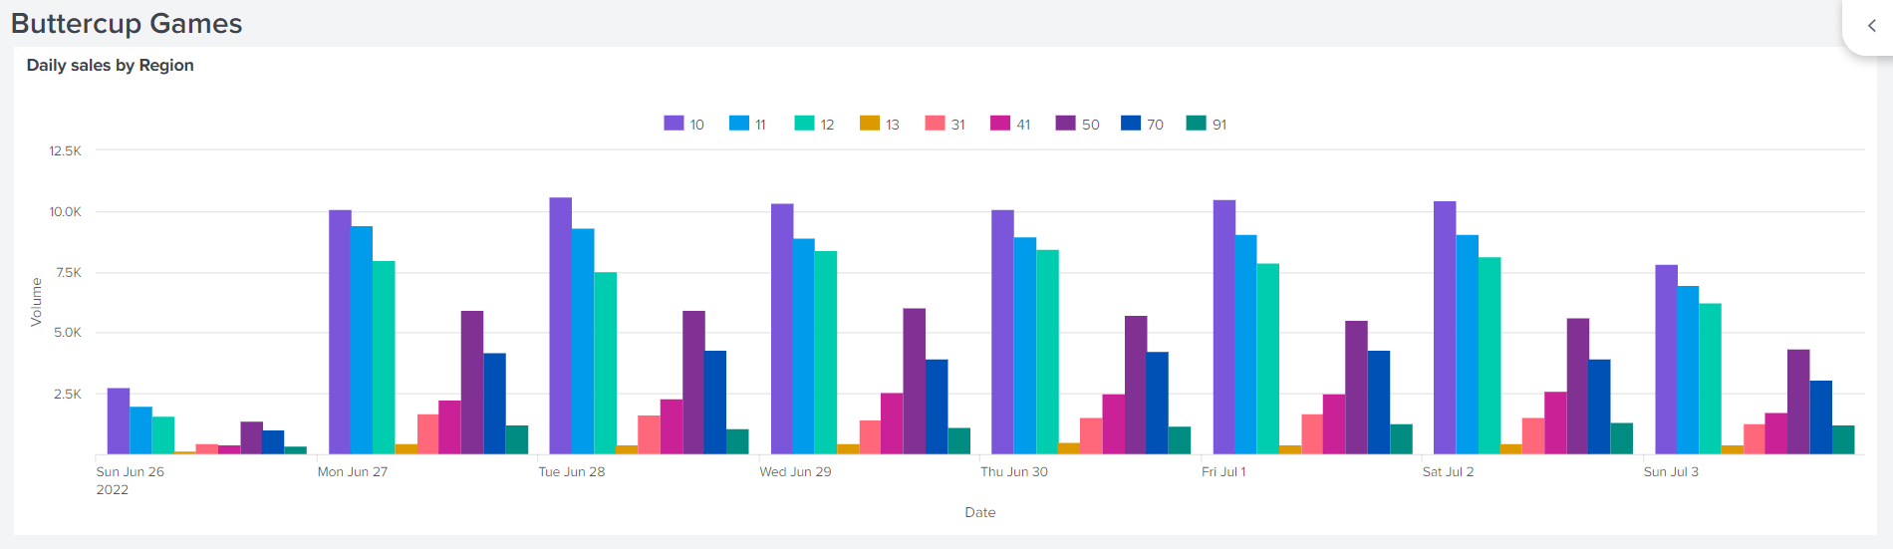
The Dashboard
Dashboard which tracks daily sales by region

Slide 9
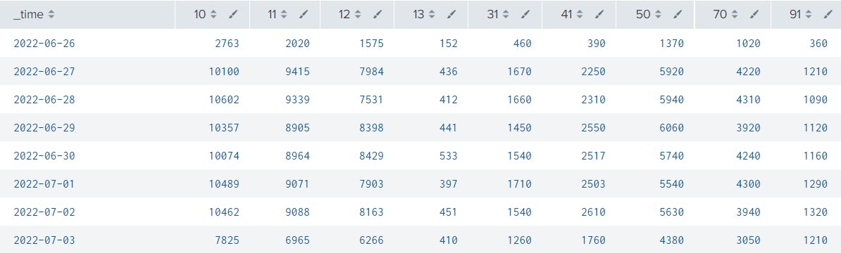
The Data
Data behind the chart

Slide 10
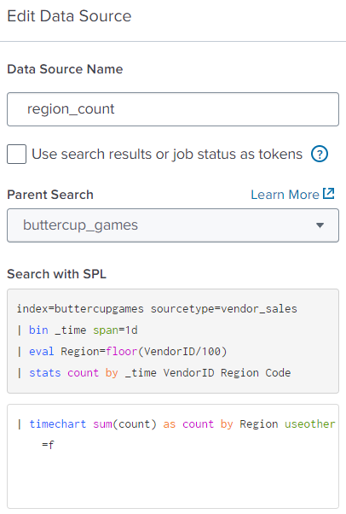
Data sources
Data source from two searches
Parent search: counts events by day, VendorID, Region, and Code
Chained search: aggregates daily counts by Region
Every time this executes daily counts are calculated from the raw index (buttercupgames)

Slide 11

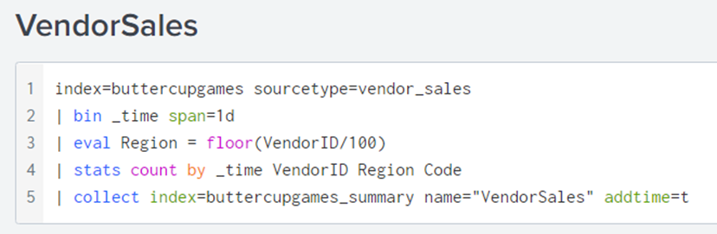
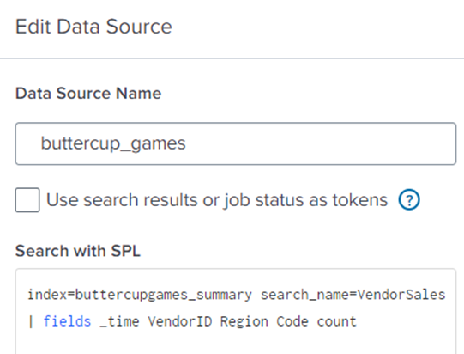
Summary Indexes
Create summary index
Populate with aggregated data
Now, update parent search to use the summary index
N.B. search_name matches the name parameter on collect
N.B. fields command to specify the fields we want

Slide 12

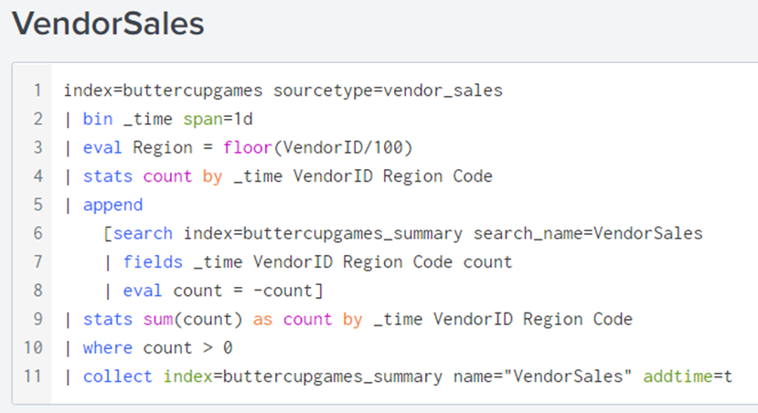
Idempotency
If the report used to populate the summary index is executed again, entries are duplicated
To be idempotent, discount any aggregated results which are already in the index and only add the additional values

Slide 13
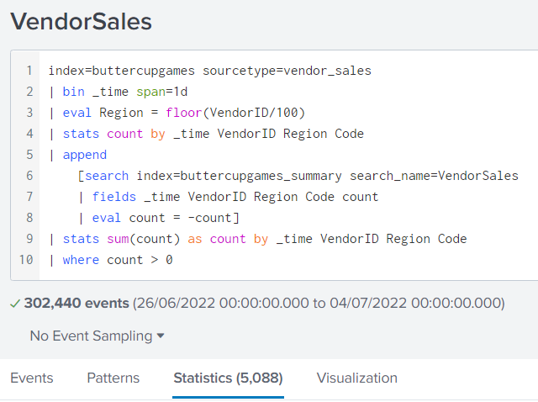
Summary Index Report

Slide 14

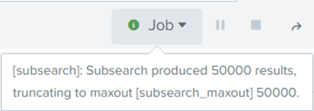
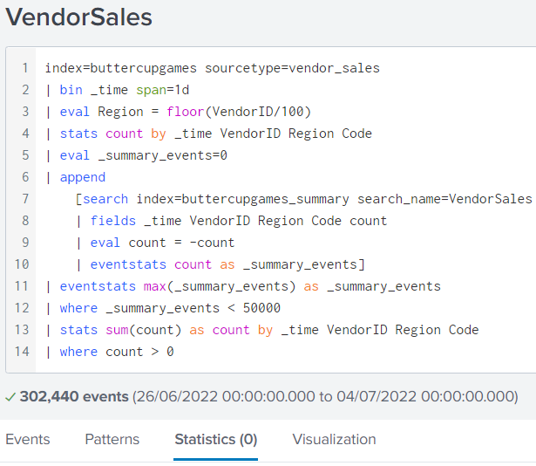
Subsearches
?#^@!
Subsearches are limited to 50,000 events; “idempotent” update would not have excluded all existing events
Count sub-search events and discontinue if too many
Report can run multiple times without double counting

Slide 15
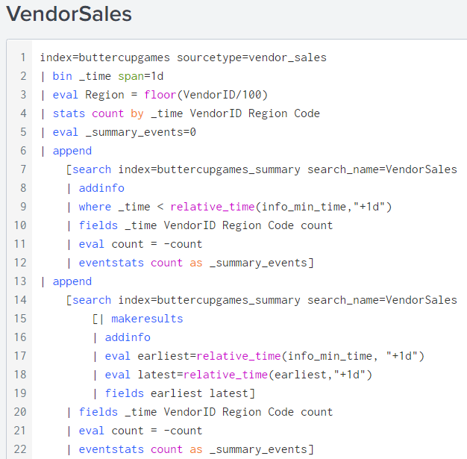
Subsearches
?#^@!
Fragment sub-search
Fortunately, there are fewer than 50,000 events per day
Option 1 - where command
Option 2 - set earliest and latest
Report runs over larger time periods by fragmentation

Slide 16
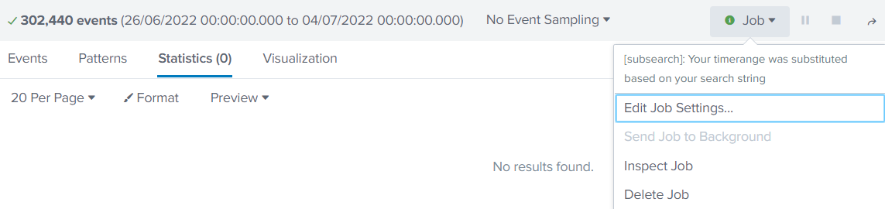
Idempotent Report
Report returns no results, it processed all events, and sub-searches have not been truncated

Slide 17
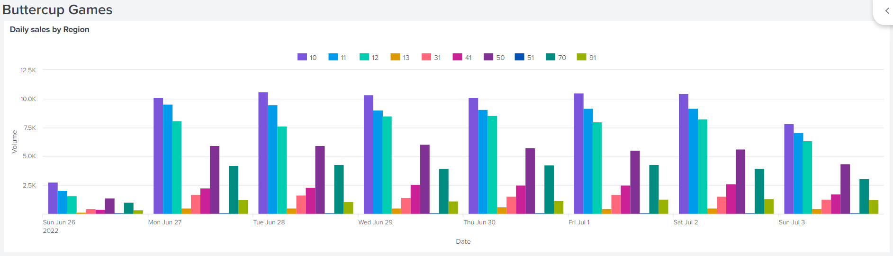
The Dashboard
Dashboard which tracks daily sales by region

Slide 18
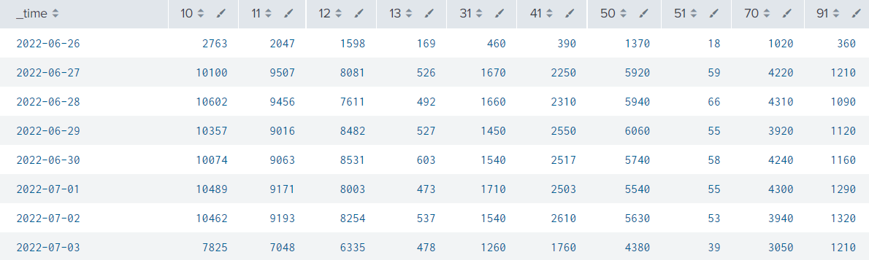
The Data
Data behind the chart

Slide 19
Caveats and other usecases
Works well with counted / summed aggregates, and, to a limited degree, for boundary aggregates (min/max)
Restricting the subsearches to 50,000 events is key.
“Late” data may be for a variety of reasons, for example, network lag; long-running transactions; additional data sources; etc.

Slide 20
Summary
Aggregated statistics in summary indexes
Mis-alignment due to late data
Using tutorial data set
Modify dashboard search to use summary index
Late data issues
Idempotency through subsearches
Fragmenting subsearches for robustness

Slide 21

THANKS!

